Slide 1



Jenkins
GitHub
CI PIPELINE PROJECT
USING JENKINS AND GITHUB.
Presented to : Mr. ASHISH AGGRAWAL
Presented by : MOHIT RAJ

Slide 2
INTRODUCTION
CI/CD (Continuous Integration /Continuous Delivery).
CI/CD is a method to frequently deliver apps to customers by introducing automation into the stages of app development . The main concepts attributed to CI/CD are continuous integration, continuous delivery, and continuous deployment.
Specifically, CI/CD introduces ongoing automation and continuous monitoring throughout the lifecycle of apps, from integration and testing phases to delivery and deployment.

Slide 3
What's the difference between CI and CD (and the other CD)?
The acronym CI/CD has a few different meanings. The "CI" in CI/CD always refers to continuous integration, which is an automation process for developers. Successful CI means new code changes to an app are regularly built, tested, and merged to a shared repository. It’s a solution to the problem of having too many branches of an app in development at once that might conflict with each other ,

Slide 4
. The "CD" in CI/CD refers to continuous delivery and/or continuous deployment, which are related concepts that sometimes get used interchangeably. Both are about automating further stages of the pipeline, but they’re sometimes used separately to illustrate just how much automation is happening.
Continuous deployment (the other possible "CD") can refer to automatically releasing a developer’s changes from the repository to production, where it is usable by customers.

Slide 5
Continuous integration
Continuous integration (CI) helps developers merge their code changes back to a shared branch, or “trunk,” more frequently—sometimes even daily. Once a developer’s changes to an application are merged, those changes are validated by automatically building the application and running different levels of automated testing, typically unit and integration tests, to ensure the changes haven’t broken the app.
CI makes it easier to fix those bugs quickly and often.

Slide 6
Continuous delivery
In continuous delivery, every stage—from the merger of code changes to the delivery of production-ready builds—involves test automation and code release automation. At the end of that process, the operations team is able to deploy an app to production quickly and easily.
The final stage of a mature CI/CD pipeline is continuous deployment. As an extension of continuous delivery, which automates the release of a production-ready build to a code repository, continuous deployment automates releasing an app to production.

Slide 7
STEPS
To configure CI pipeline with Jenkins , the first
and the most obvious step is to install Jenkins.
Follow the step to do so :
Launch an instance of Red Hat (instance type t2.small/t3.small).Also allow port 8080 in security group while launching.
Login in to the machine using SSH on command prompt . Now execute the following commands to install jenkins :

Slide 8
sudo –i
Yum install wget –y
sudo wget –o /etc/yum.repos.d/jenkins.repo \
https://pkg.jenkins.io/redhat-stable/jenkins.repo
sudo rpm --import
https://pkg.jenkins.io/redhat-stable/jenkins.io-2023.key
sudo yum upgrade
sudo yum install java-17-openjdk
sudo yum install jenkins
sudo systemctl daemon-reload.

Slide 9
Following screenshots of the executed commands are attached for reference.uou can also visit to https://www.jenkins.io/doc/book/installing/linux/#red-hat-centosto see the manual and commands for installing jenkins on Red Hat Linux.

Slide 10
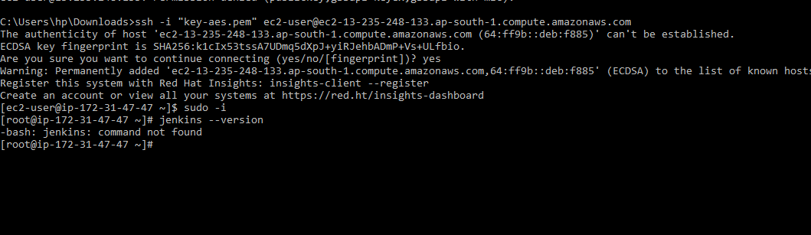

Slide 11
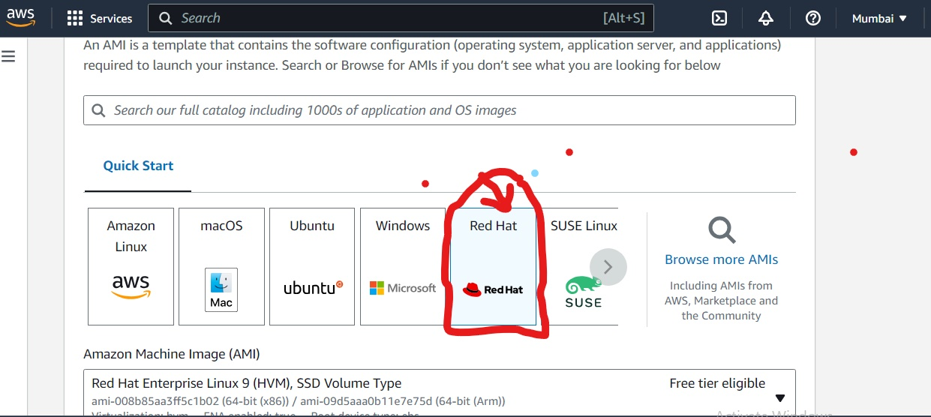

Slide 12
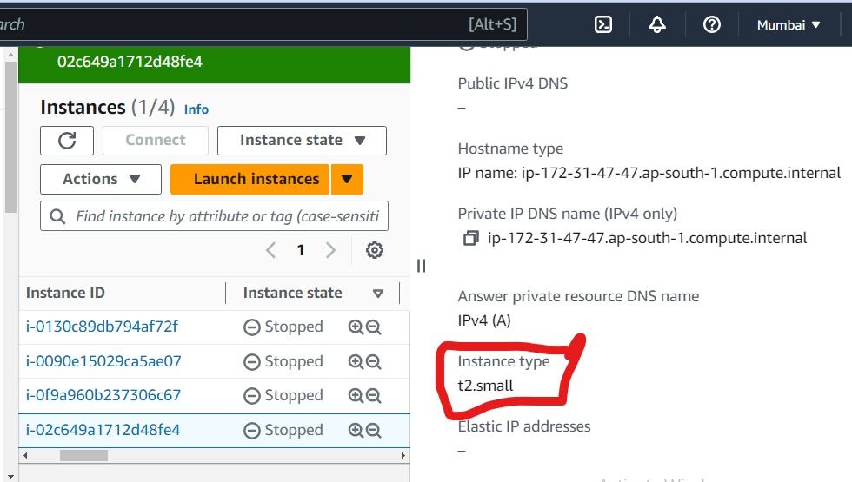

Slide 13
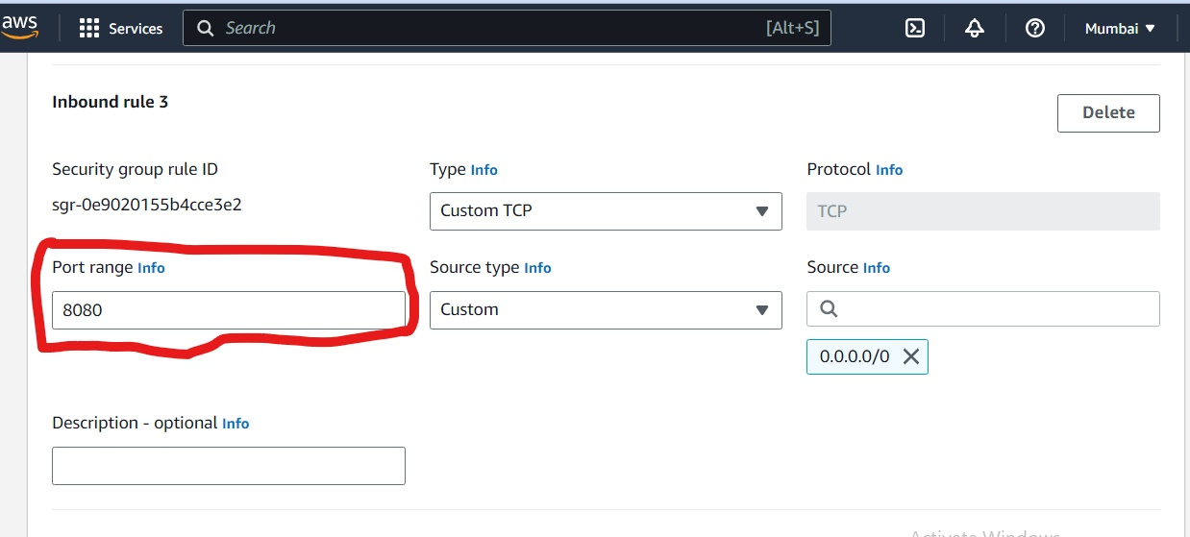

Slide 14
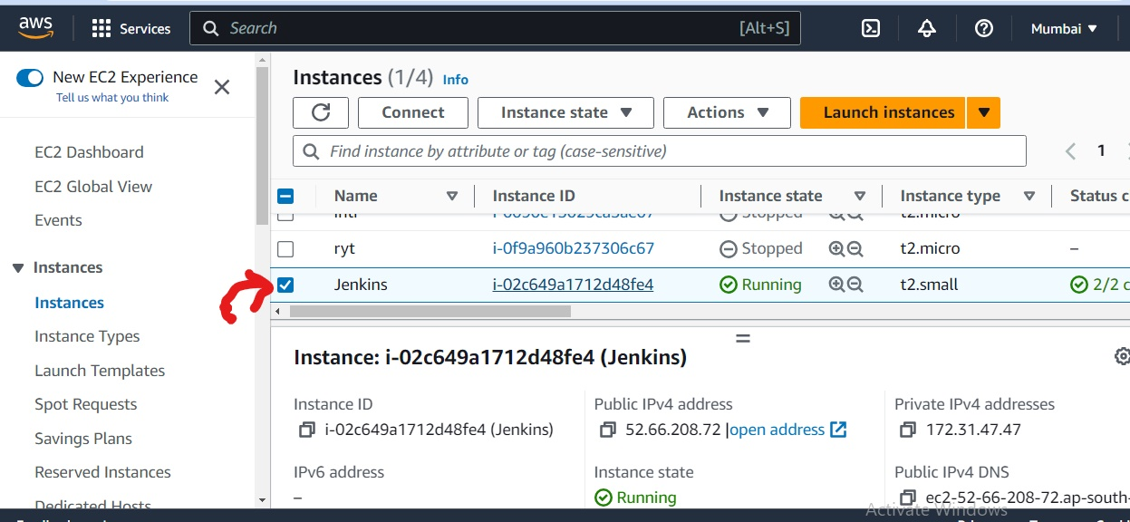

Slide 15
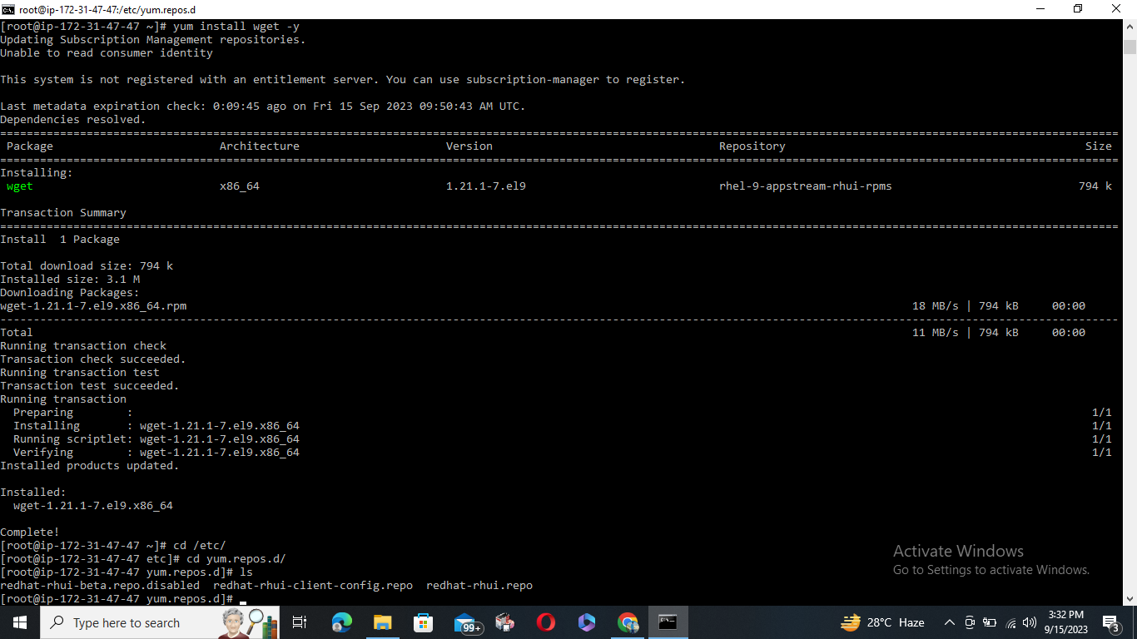

Slide 16
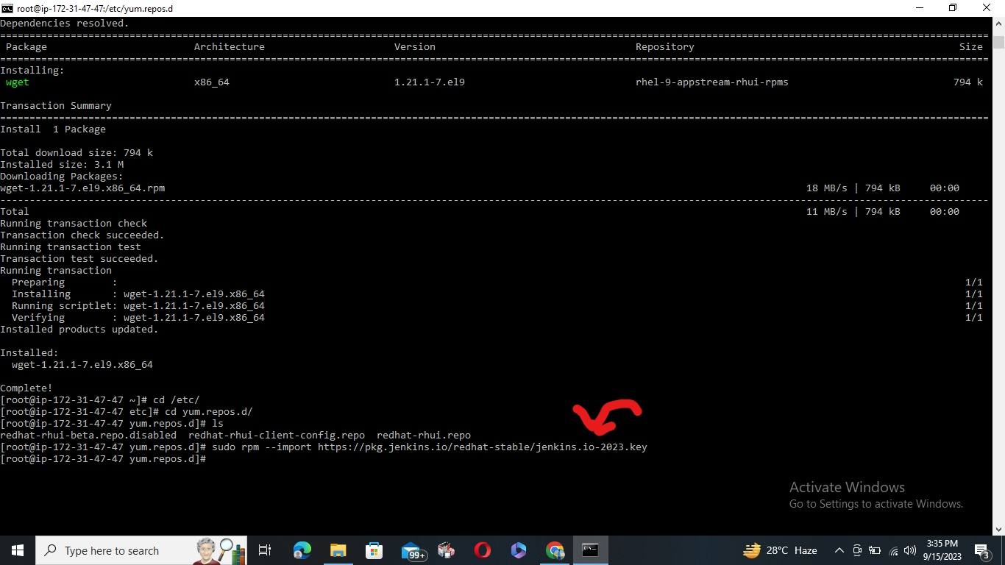

Slide 17
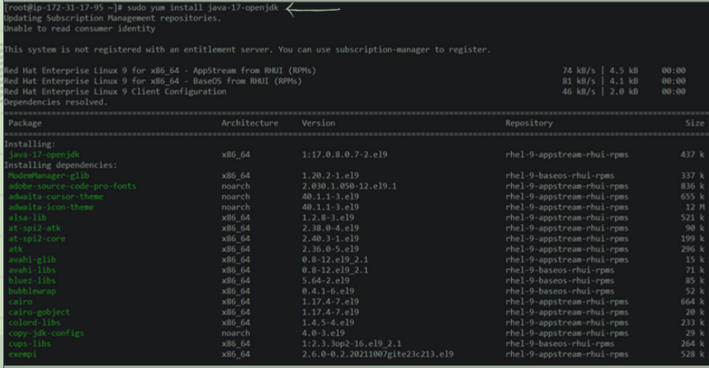

Slide 18
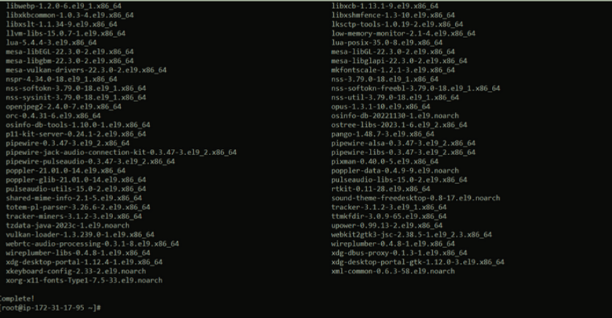

Slide 19
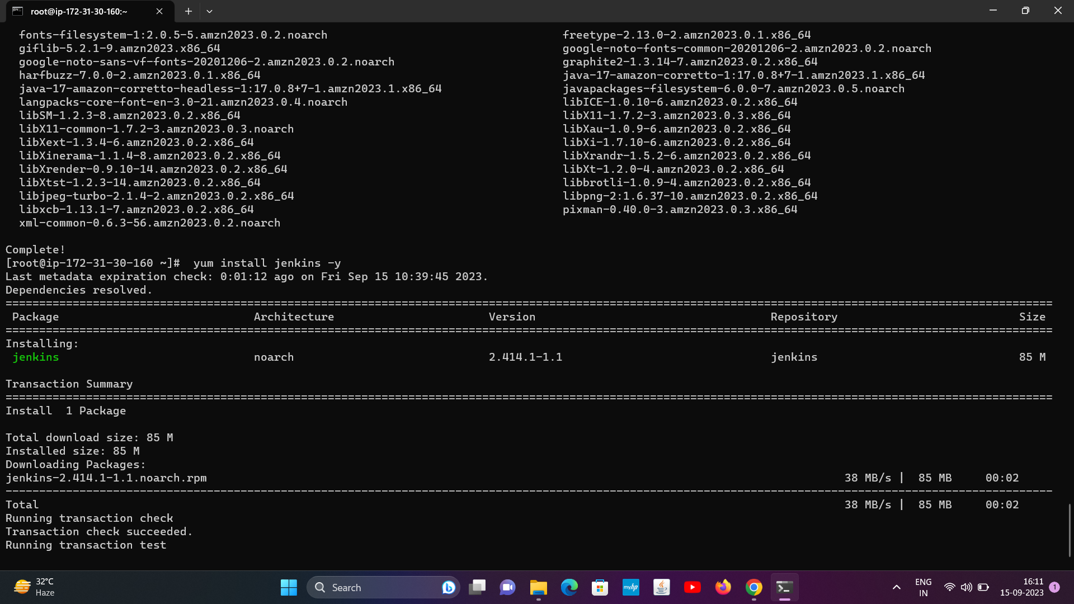

Slide 20
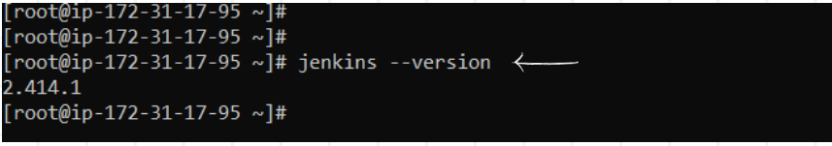
Check the installed jenkins version : jenkins --version Now enable the jenkins service using following command : systemctl enable --now jenkins Now paste the “publicIP:8080" on browser to see jenkins login page . For example :

Slide 21

To unlock this, open the following file in terminal and paste the password here: cat/var/lib/jenkins/secrets/initialAdmi nPassword

Slide 22
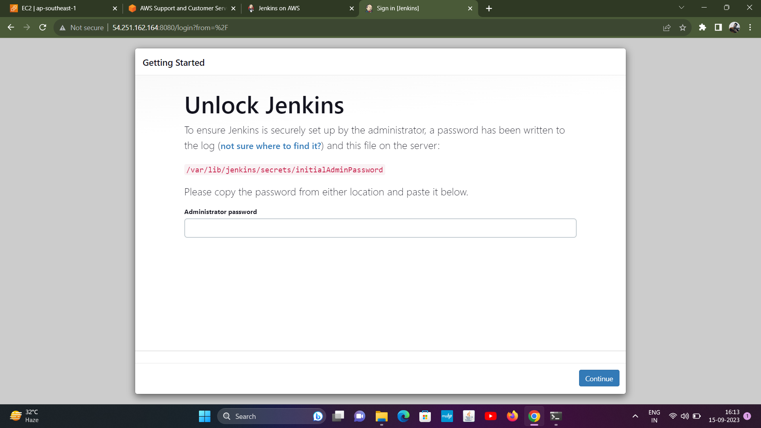

Slide 23
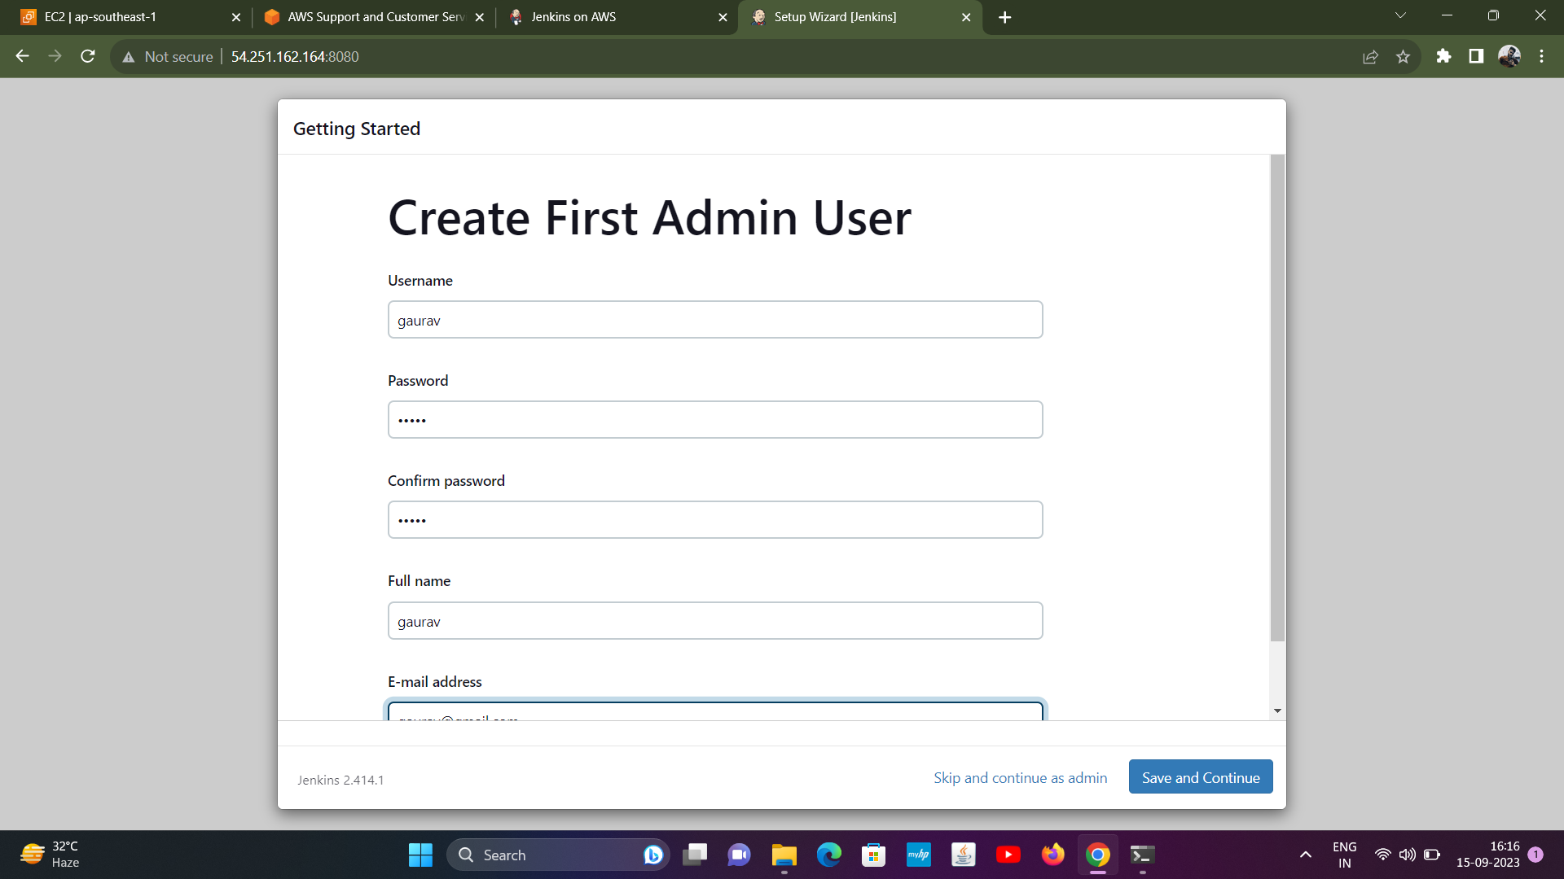

Slide 24
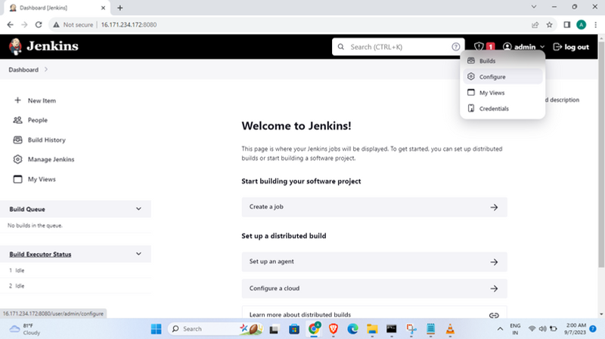

Slide 25
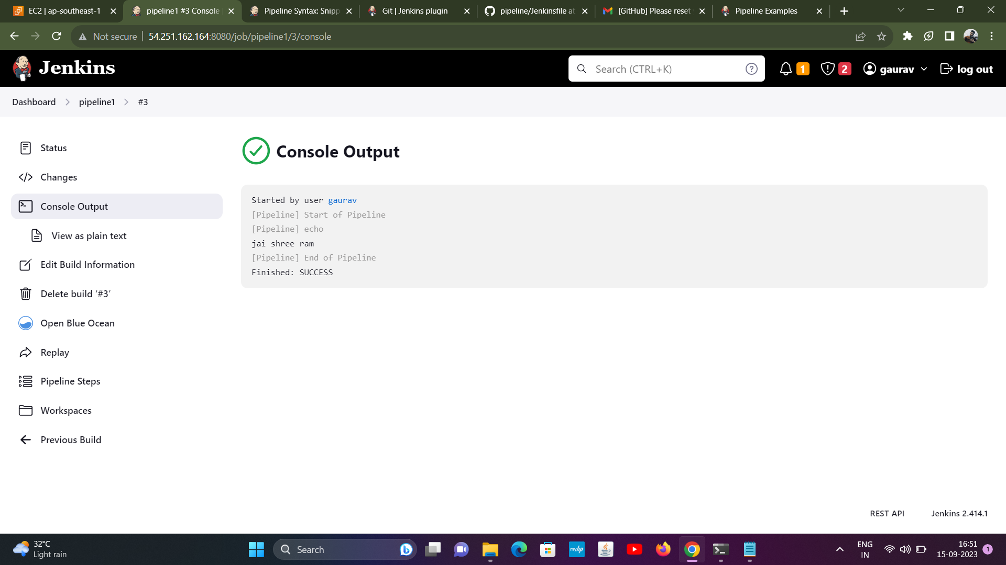
mraj

